Slide 1
Problem Statement
PS-3 Customized AI Kitchen for India
Domain: Object Detection and Recipe Generation
A few use cases could include:
Deployed in a Kitchen as an Assistant
Could be modified for a calorific counter
Can be used as grocery shopping assistant

Slide 2
Unique Idea Brief (Solution)
The end term plan is to incorporate the model in a flutter based and/or xcode based application for android and iOS deployment.
The application is supposed to act as an assistant of sorts within the kitchen, I plan on adding a ‘homeassistant’ plugin allowing the model to understand the time of the day, ingredients available, members within the house and food preferences allowing it to curate a recipe.
Given it’s scalability the model in theory can be trained to be specialised in giving recipes specific to a household member.
This will be integrated into a docker container making the model self-hostable to ensure consumer privacy as well as satisfaction.

Slide 3
Features Offered
Ingredient Recognition:
Utilising a CNN based on MobileNetv2 for higher efficiency and accuracy, it is capable or recognising a wide variety of ingredients from images.
Extensibility:
The model architecture and pipeline are easily extensible for additional classes of ingredients, this in turn supports greater integration with other data sources and API’s for enhanced functionality.
Data Augmentation:
Implemented augmentation techniques to improve model generalisation and overall robustness. The techniques include horizontal flip, rotation, rescaling, shear and zoom transformations, nearest fill as well as width and height shift.

Slide 4
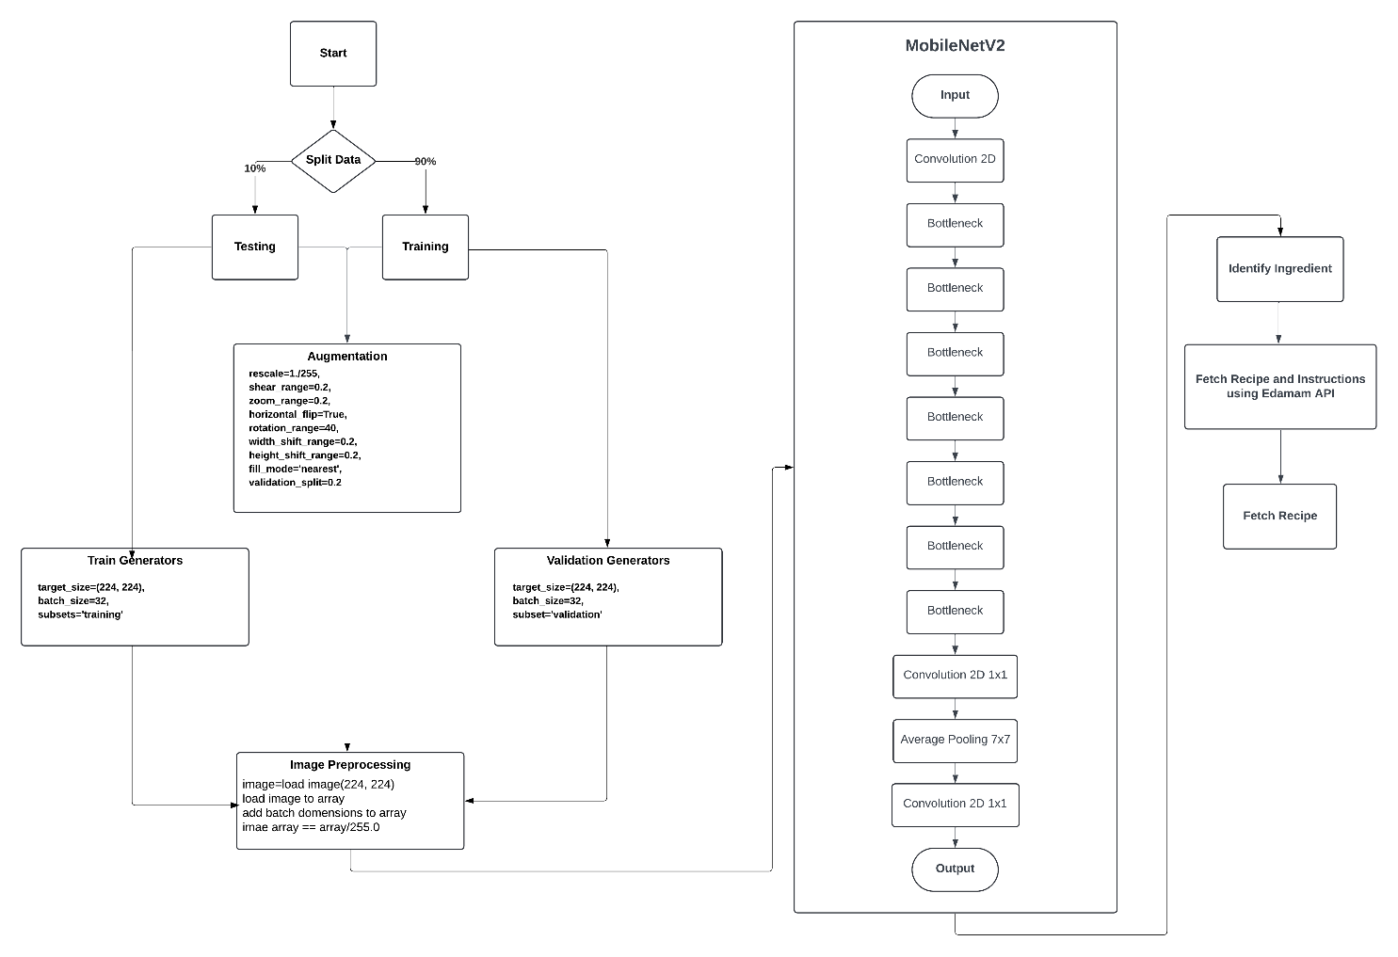
Process flow

Slide 5
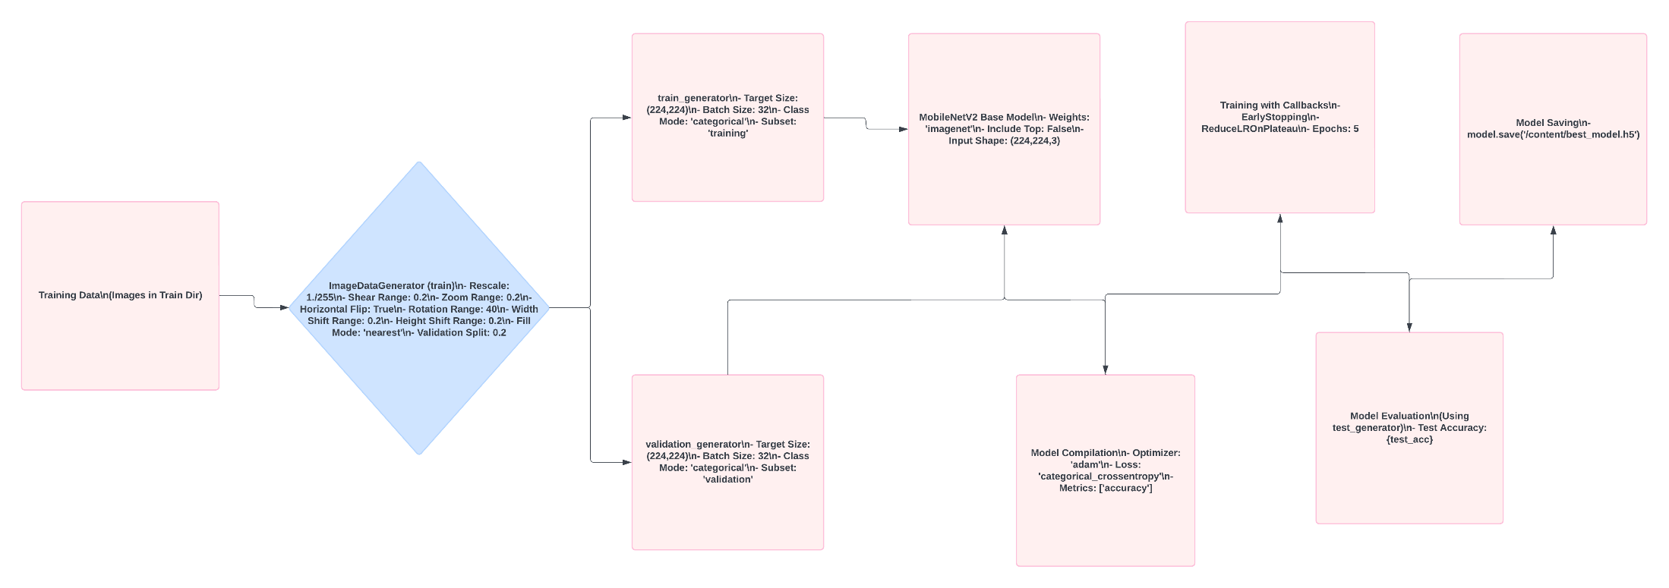
Architecture Diagram

Slide 6
Technologies used
Tensorflow
Sequential
InceptionV3
MobileNetV2
Average Pooling
CSV Logger
Regularizer
Keras
Jupyter Notebook
Adam Optimizer

Slide 7
Team members and contribution:
Bryan George:
Complete project was done by me

Slide 8
Conclusion
I trained a model to identify ingredients used in the kitchen for object detection and using the same for a recipe generation based on the ingredients identified.
Although the implemented model has no deployment yet, a future deployment idea could be a website or an app where we show the camera the ingredients and identifies them and gives a recipe based on those ingredients helping the user decide what to cook using a handsfree application.

